Slide 1

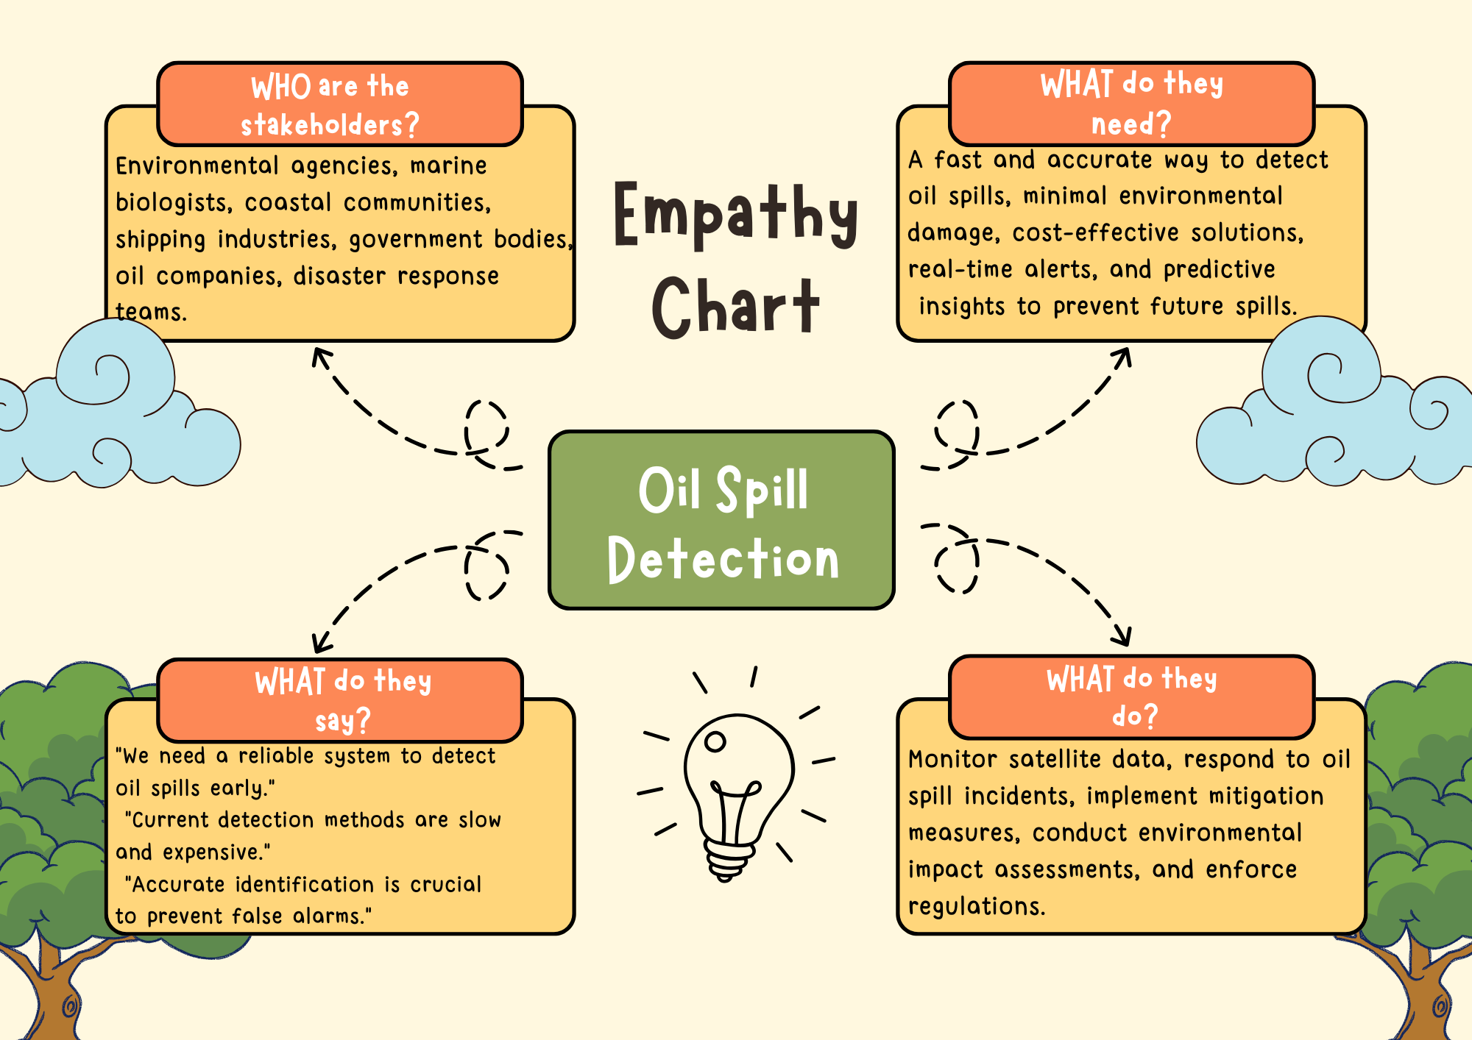
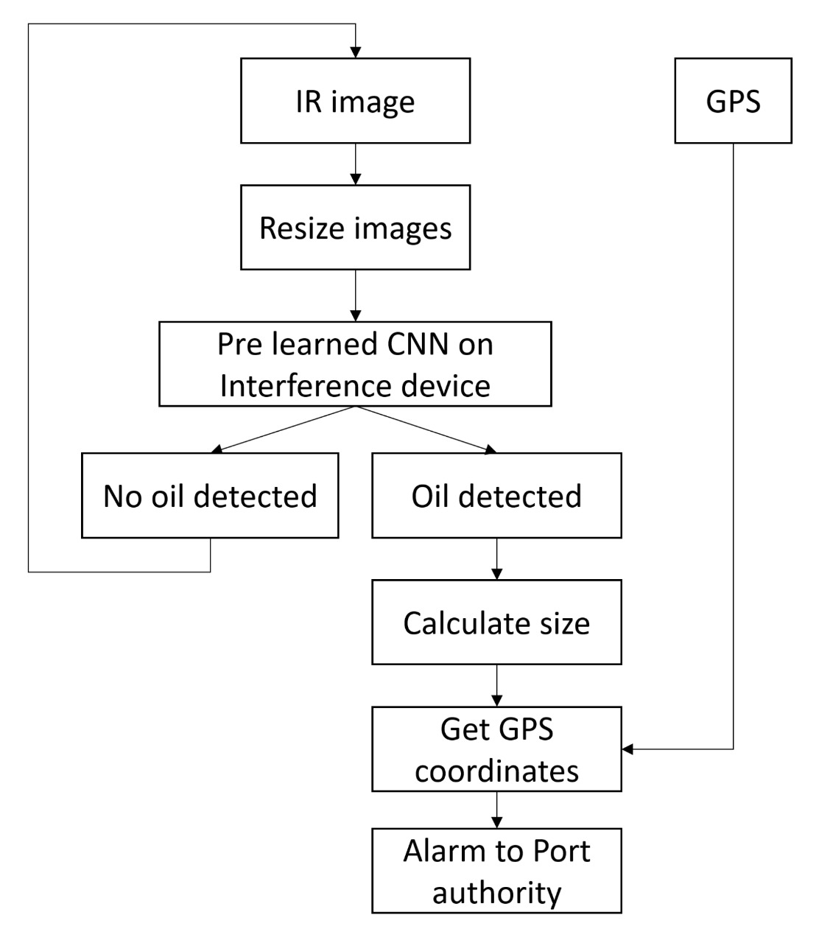
Proposed Architecture/ Diagram:
MIT SCHOOL OF COMPUTING
Class : TY AIA 3
Group Id: 18
DEPARTMENT OF COMPUTER SCIENCE & ENGINEERING
Oil Spill Detection
AI/ML-based oil spill detection system
Neha Hambir, Archana Kumar, Vanshaj Saraf, Krushnal Patil
Faculty Guide:
Prof. Nilesh Kulal
Problem statement
Oil spills pose a severe threat to marine ecosystems, requiring rapid detection for effective mitigation. This project aims to develop an AI/ML-based system for oil spill detection using satellite imagery. By leveraging image processing and deep learning techniques, the model will identify oil spills, differentiate them from water.
Proposed Solution
The proposed solution utilizes AI/ML-based image processing techniques to detect oil spills from satellite imagery with high accuracy. By leveraging deep learning models such as CNNs, the system will differentiate oil spills from water, ensuring precise identification.
Scope and Feasibility
This project utilizes satellite imagery and AI/ML models for real-time oil spill detection. It ensures accurate classification using deep learning technique like CNN. Feasibility is high due to accessible datasets, cloud computing, and automation, making it scalable for environmental monitoring and emergency response applications.

